Slide 1
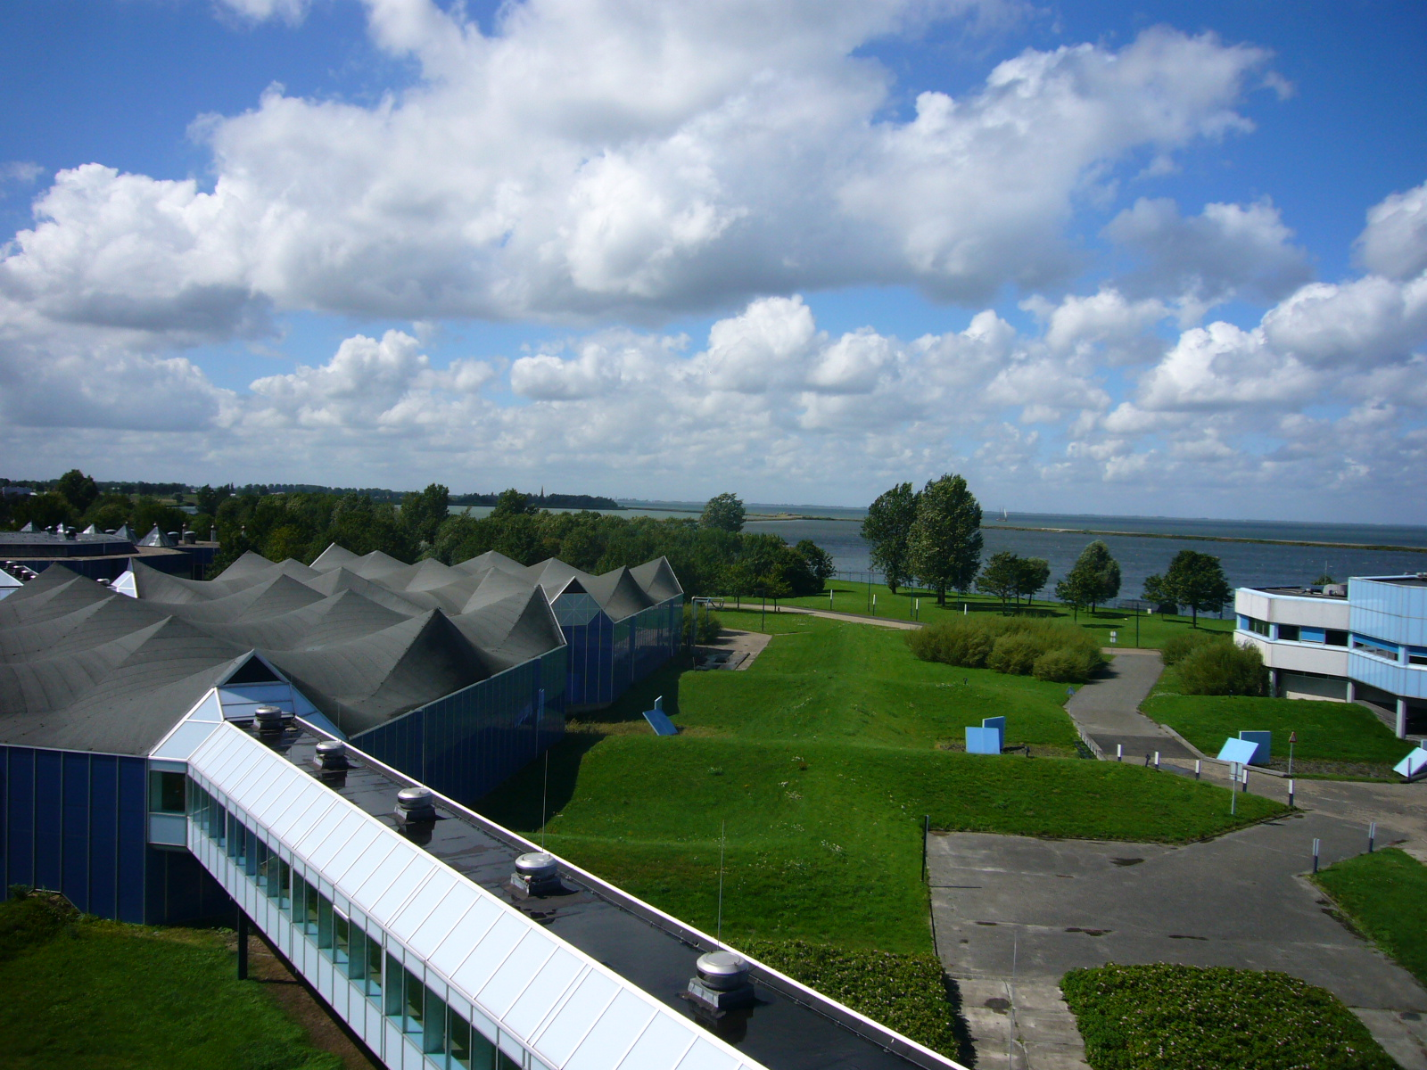
Water treatment plant Prinses Juliana
Student tour – 27 June 2022
Prest, E.; Gude, J.; Rietveld, M.

Slide 2
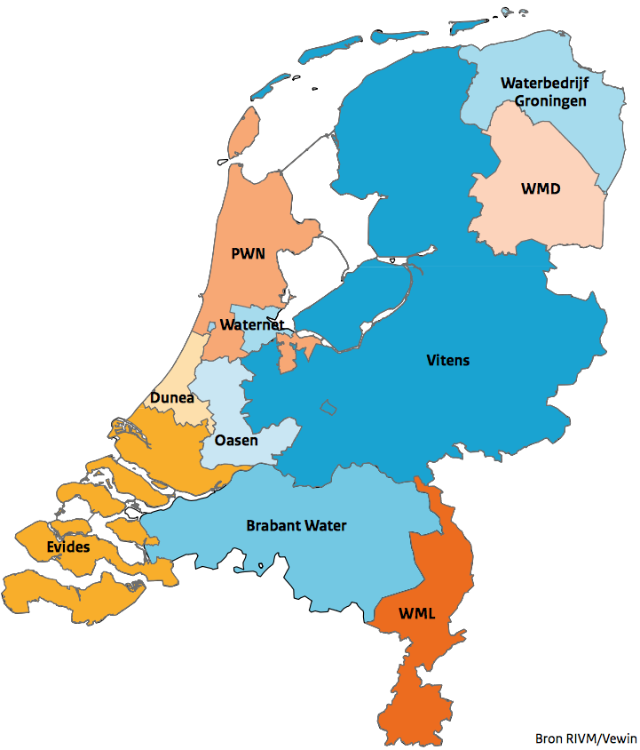
PWN
Provinciale Waterleidingbedrijf Noord-Holland
600 employees
annual turn-over € 180 million
since 1990 private owned company
100% owned by the Province of North Holland
Non-profit organization

Slide 3
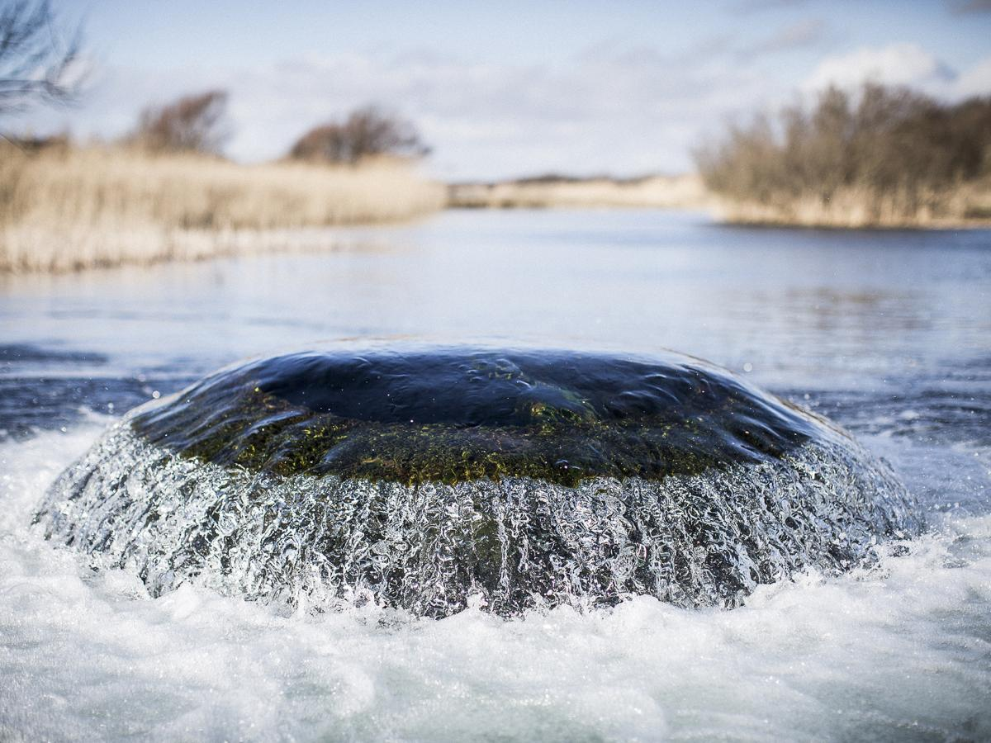
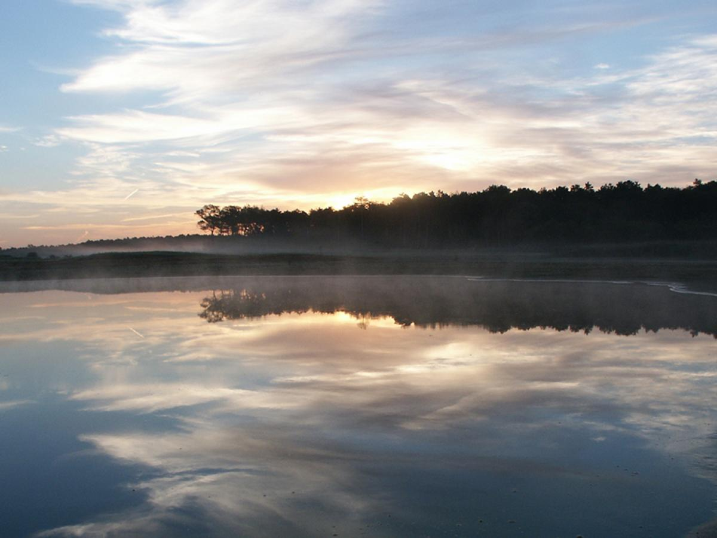
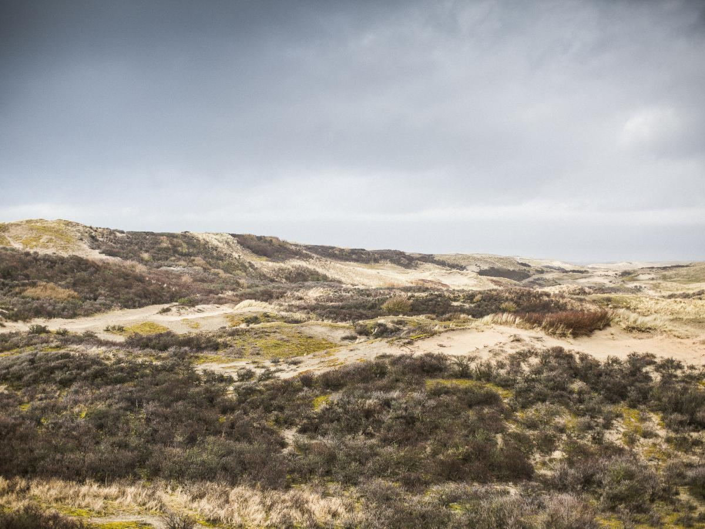
PWN
Provinciale Waterleidingbedrijf Noord-Holland
Drinking water production
annual drinking water production: 105 mln m³
distribution to 780,000 connections
1.7 million customers
about 130 L per day per person
10.000 km distribution network
Preservation of dune area
7.400 hectares dune area
7 million visitors per year
3 camp sites

Slide 4



PWN has three subsidiaries
engaged in innovative purification techniques and makes these available to drinking water companies all over the world.
provides support for numerous development projects by providing advice on drinking water supplies in countries where sufficient and clean drinking water is not so obvious.
consist of three campsites in the PWN area: Camping Bakkum, Geversduin and De Lakens. All campsites have been awarded a golden Green Key.

Slide 5
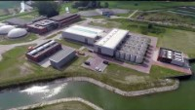
https://youtu.be/hQIE1rdZ8hY

Slide 6
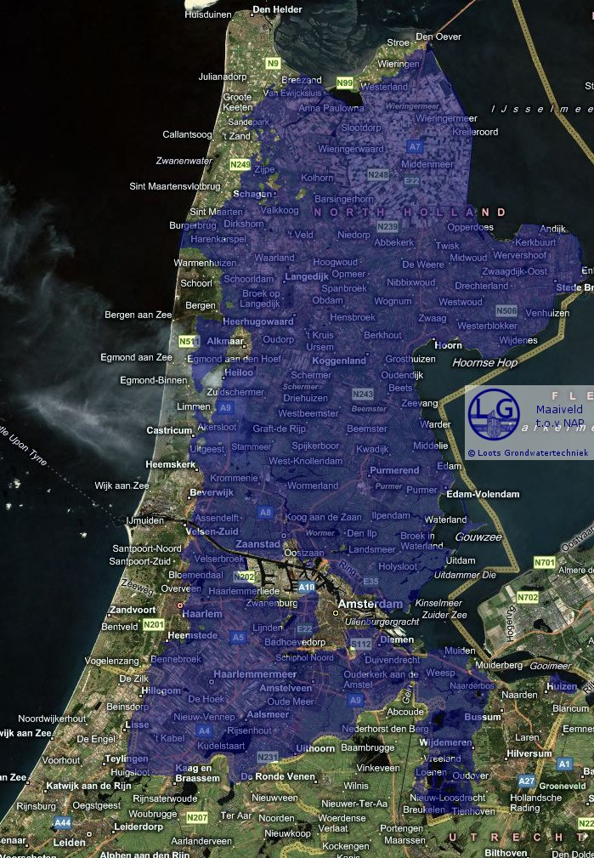
Water source challenge
most province below sea level
salty groundwater
IJssel Lake only available source
dominantly fed by the river Rhine
under the influence of industry, recreation, population, agriculture
high contamination level (delta of Europe)
95% surface water
5% groundwater

Slide 7
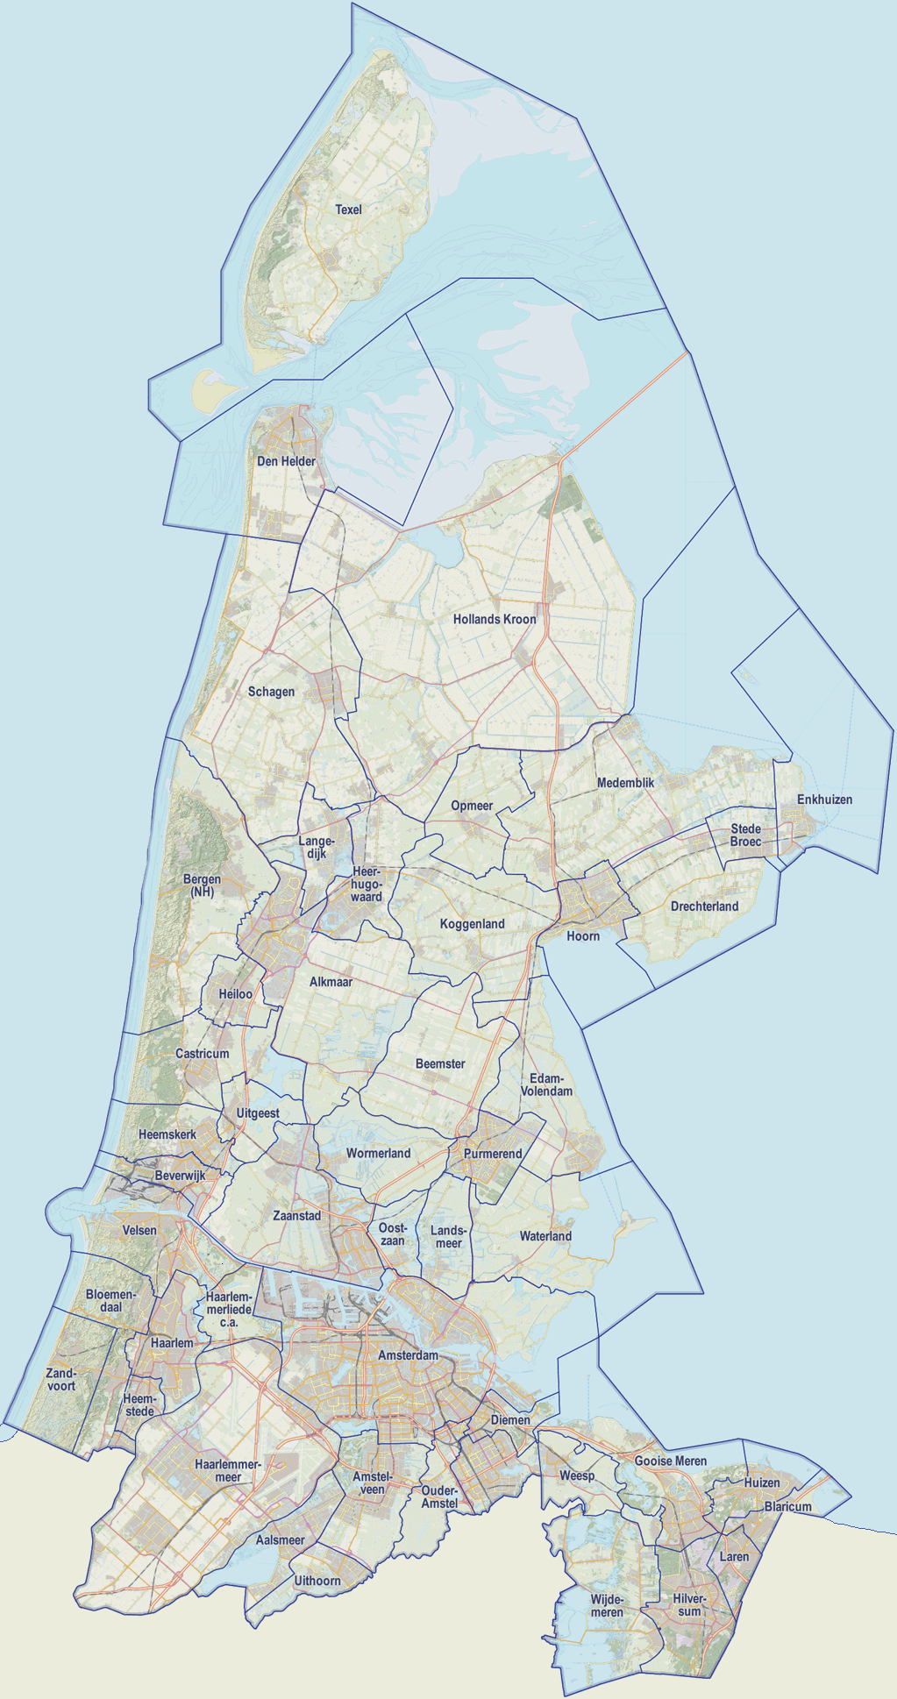
Drinking water production and transport
WTP – Martien den Blanken
WTP – Princess Juliana
WTP – Jan Lagrand
Dune infiltration area
WTP – Wim Mensink
WTP – Bergen
WTP – Laren

Slide 8
UV/H₂O₂
UF
Lake IJssel
GAC
RO
drum screens
Dune infiltration
mixing
flocculation
pellet softening
aeration
sedimentation
RSF
RSF
ClO₂
GAC
Distribution network

Slide 9
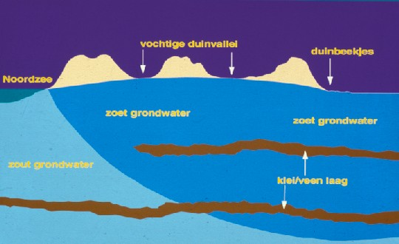
Dune water treatment
1920 – 1950 circa
Dune water
Aeration
Sand filtration

Slide 10
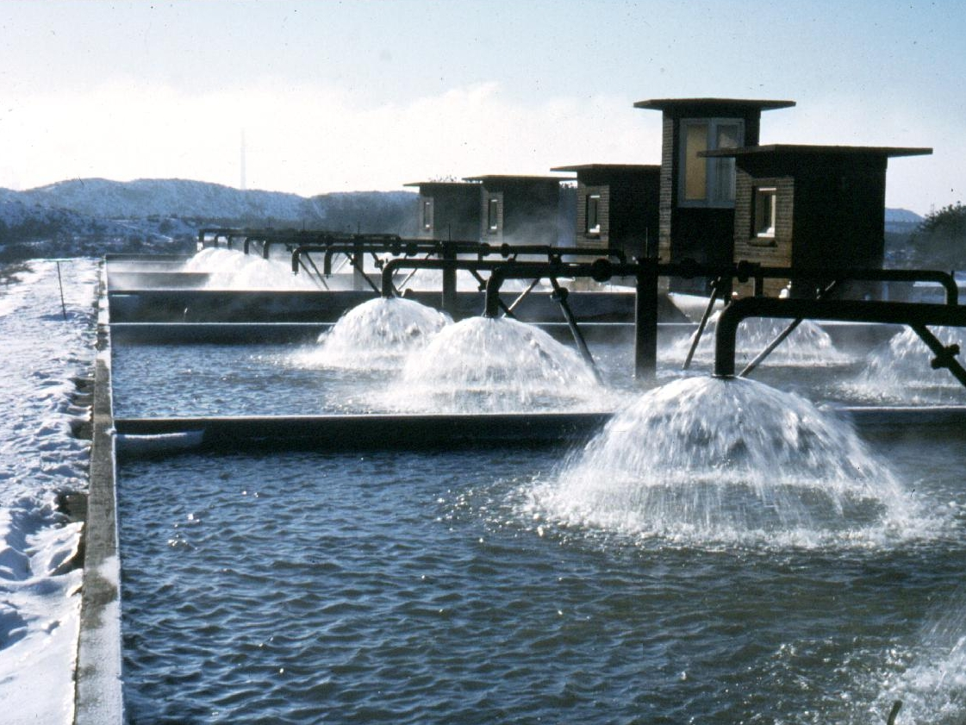

Slide 11
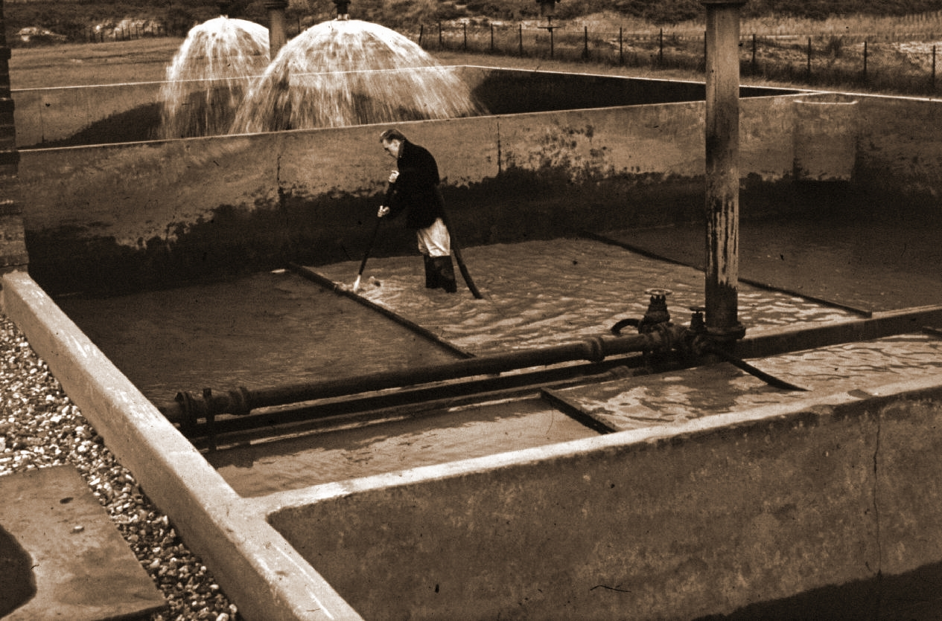

Slide 12
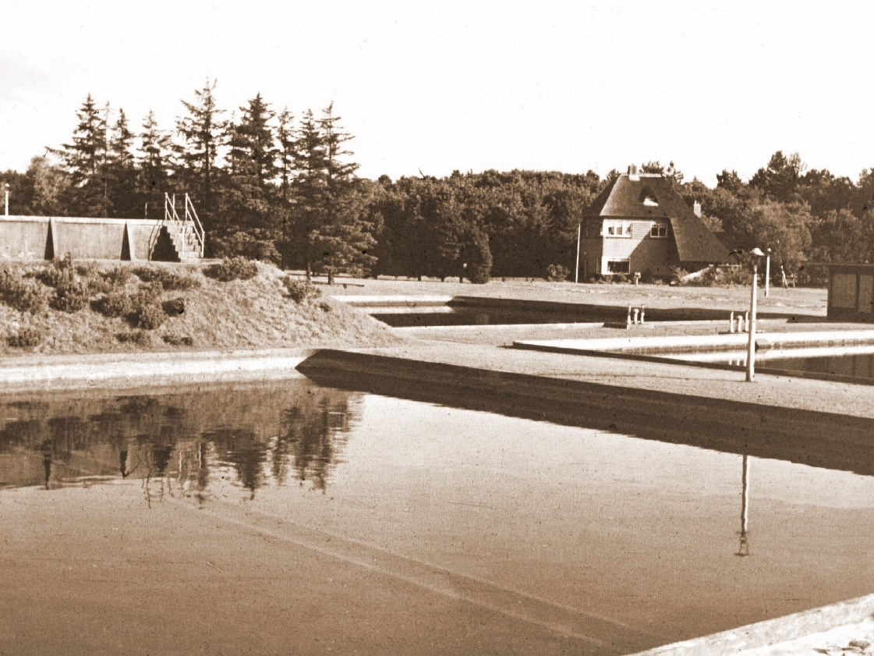

Slide 13
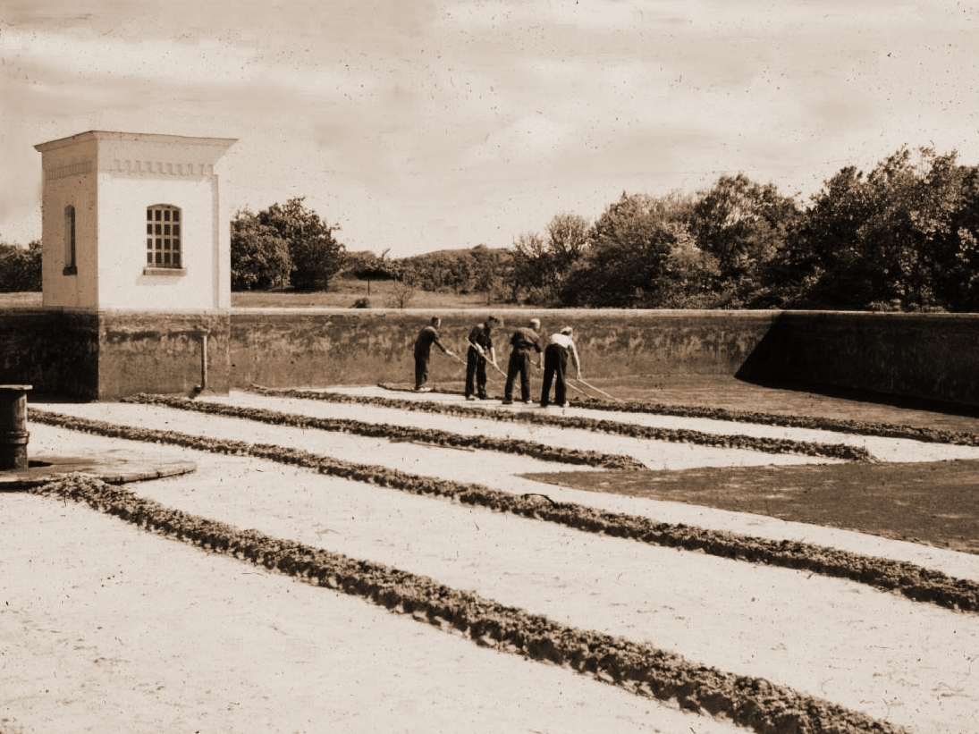

Slide 14
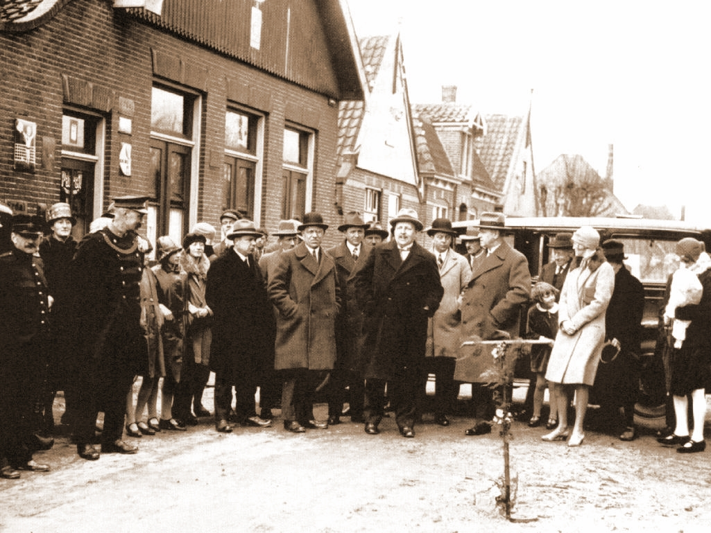

Slide 15
in 1977 erbij : Den Helder
in 1982 erbij : Bussum
in 1997 erbij : WLZK

Slide 16
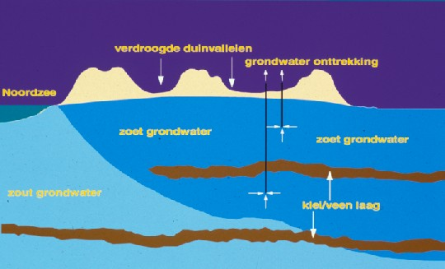
Dune water treatment
1920 – 1950 circa
Dune water
Aeration
Sand filtration

Slide 17
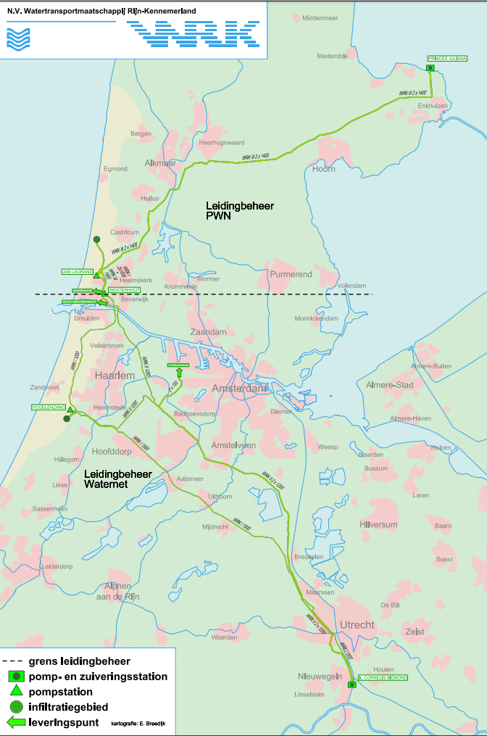
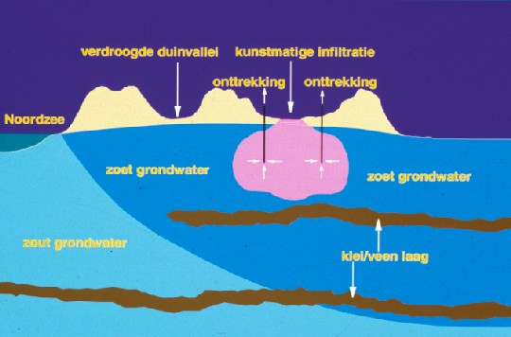
Dune water treatment
1950 – 1981 circa
Rhine river
RSF
Dune water
Aeration
Sand filtration

Slide 18
Dune water treatment
1981 – 2001 circa
Rhine river
RSF
Dune water
Aeration
Sand filtration
1957 - WRK I - 1.5 meter in diameter – 84 km
1967 - WRK II – 2 x 1.2 meter in diameter – 84 km
1981 - WRK III – 2 x 1.4 meter in diameter – 56 km

Slide 19
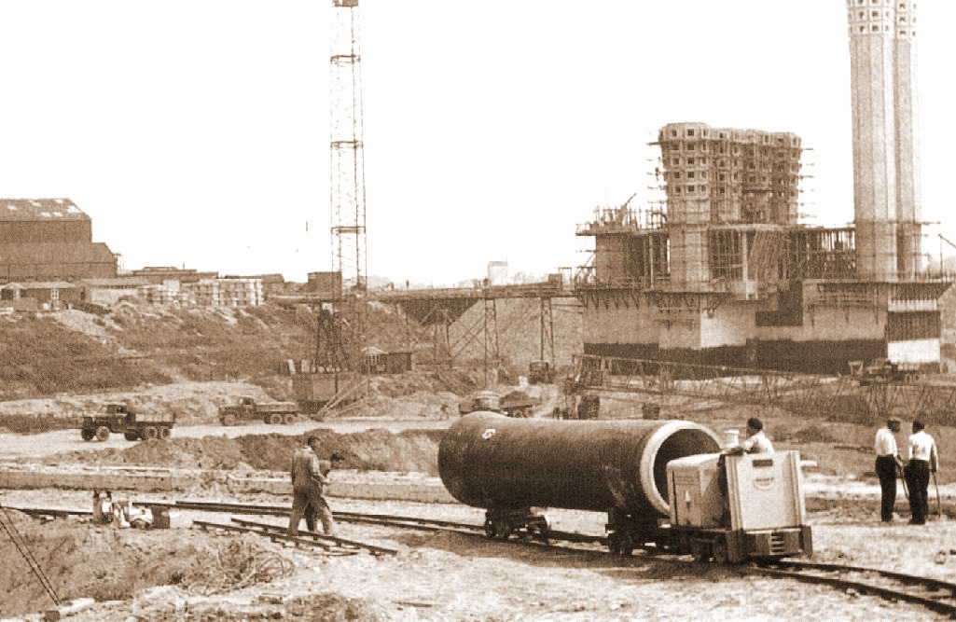

Slide 20
1980
WRKIII
WPJ

Slide 21
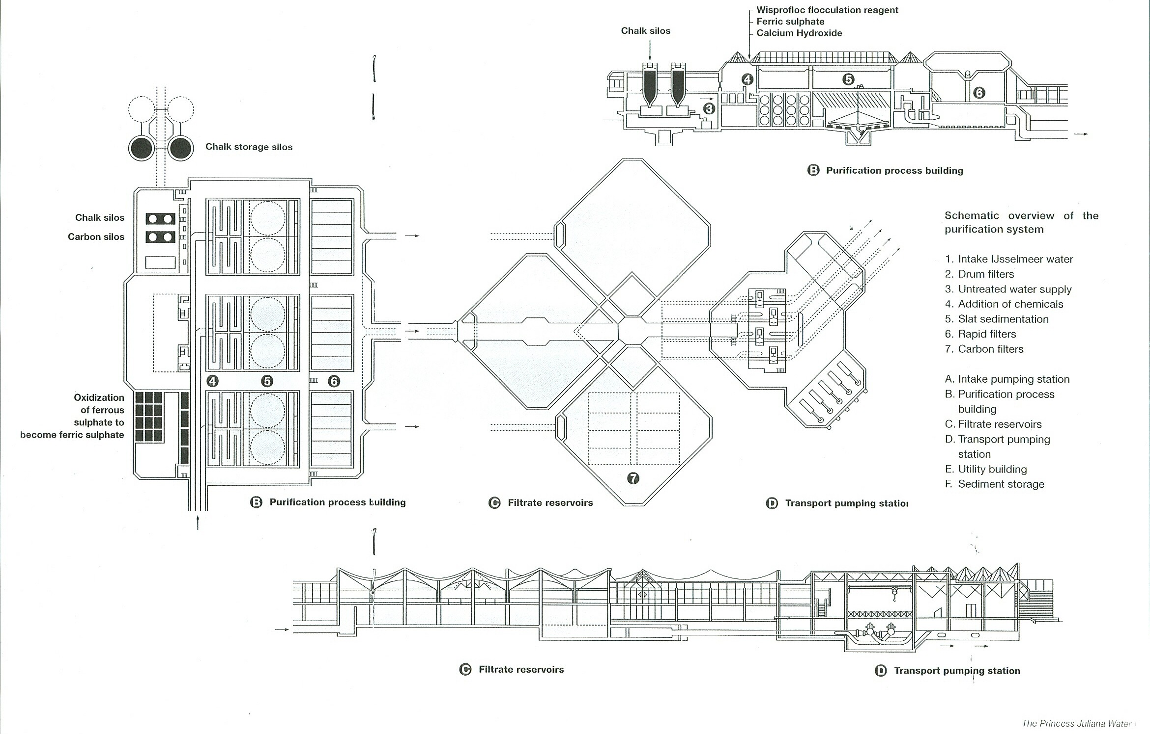

Slide 22
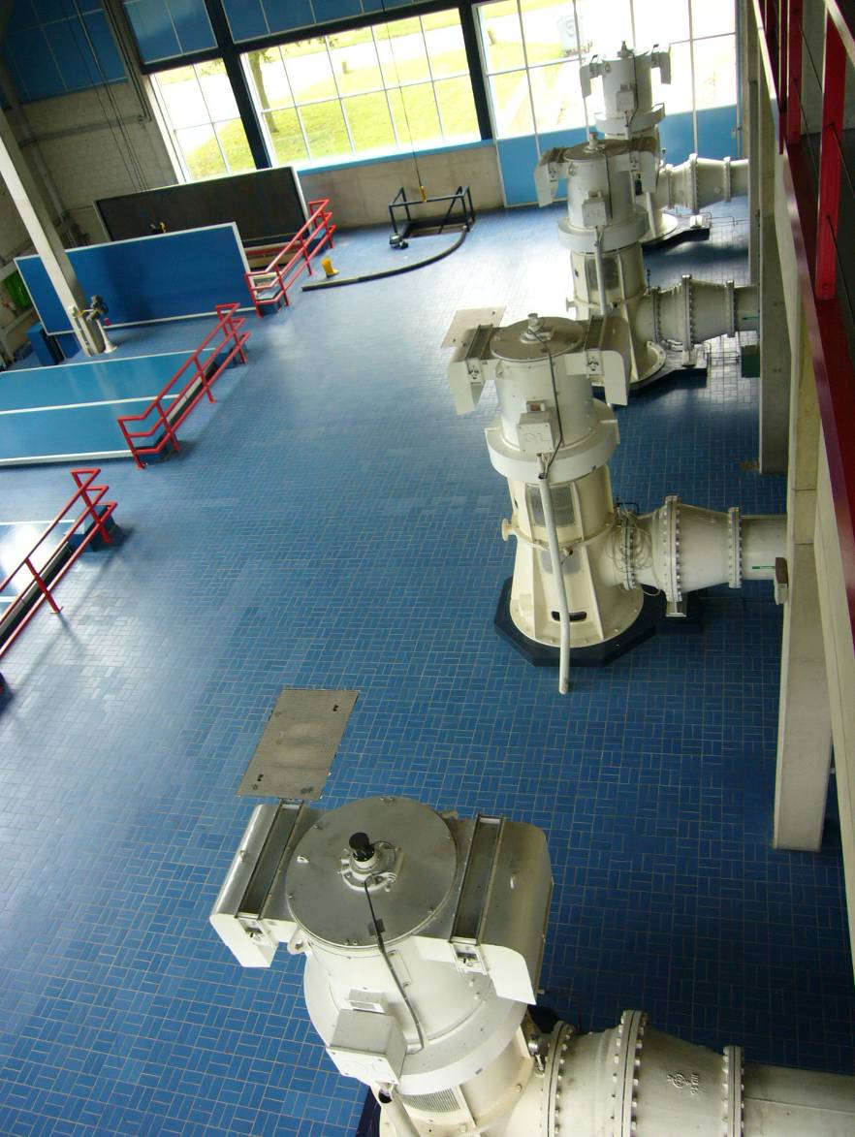
WPJ – Process flow
Lake IJssel
d_{m} = 200 µm
drum screens
mixing
flocculation
sedimentation
Q_{max} = 14.000 m³/h
RSF
GAC

Slide 23
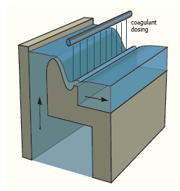
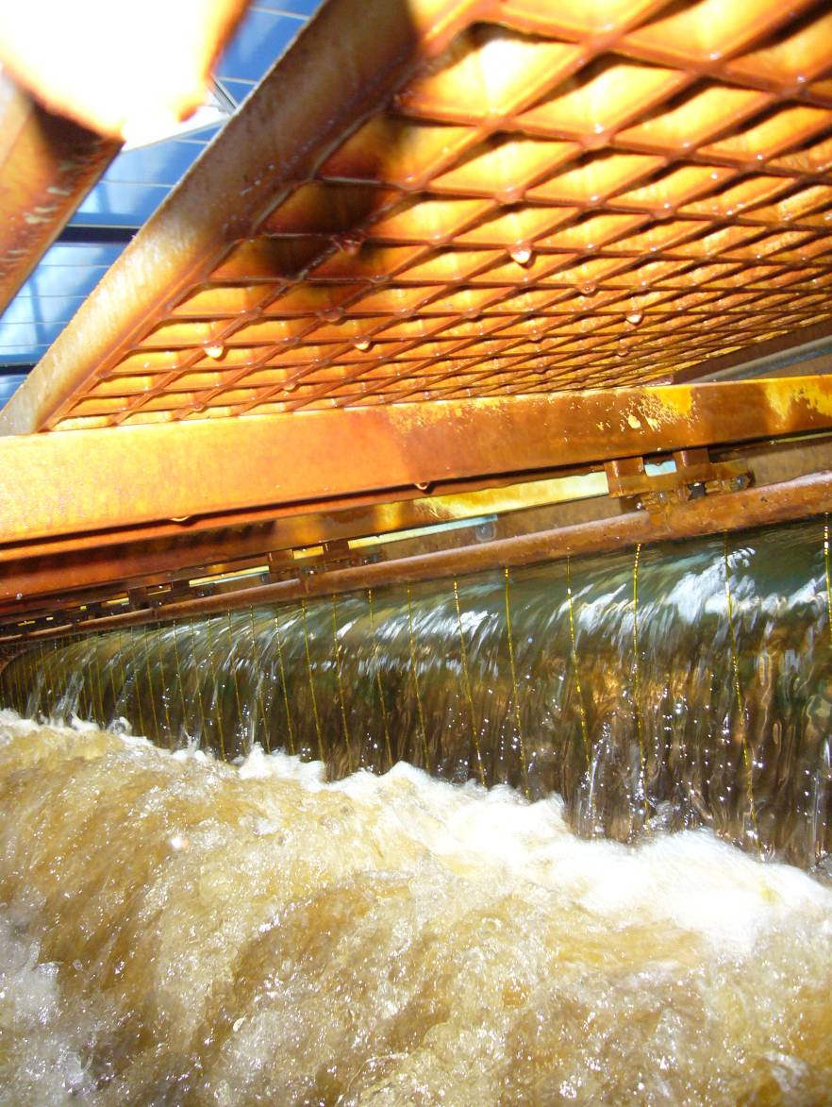
WPJ – Process flow
Lake IJssel
20 mg/l as Fe³⁺
@ pH 8 w NaOH
drum screens
mixing
flocculation
sedimentation
RSF
GAC

Slide 24
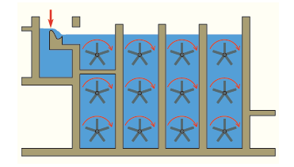
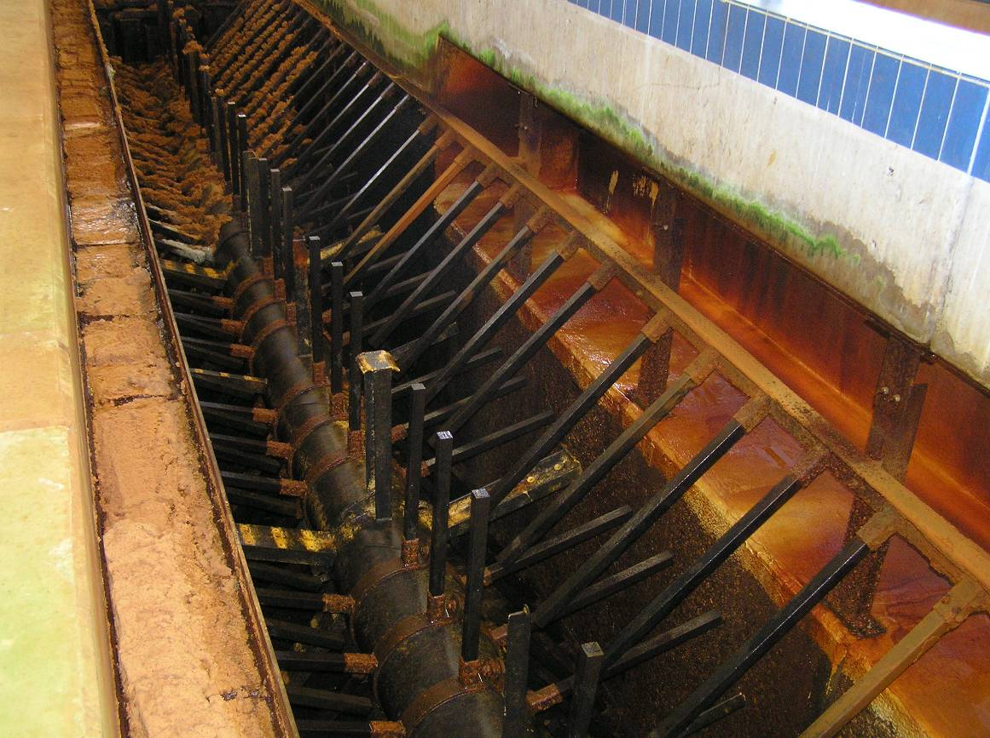
WPJ – Process flow
Lake IJssel
drum screens
mixing
flocculation
sedimentation
RSF
GAC
0.1 – 2.5 mg/l WisPro
G_{T} ∼ 22.000

Slide 25
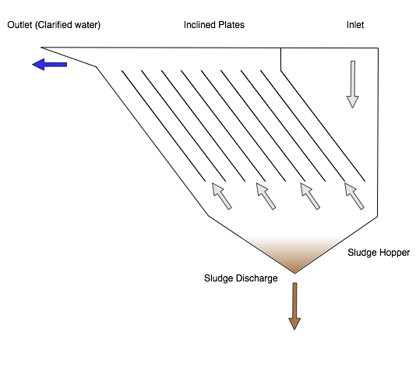
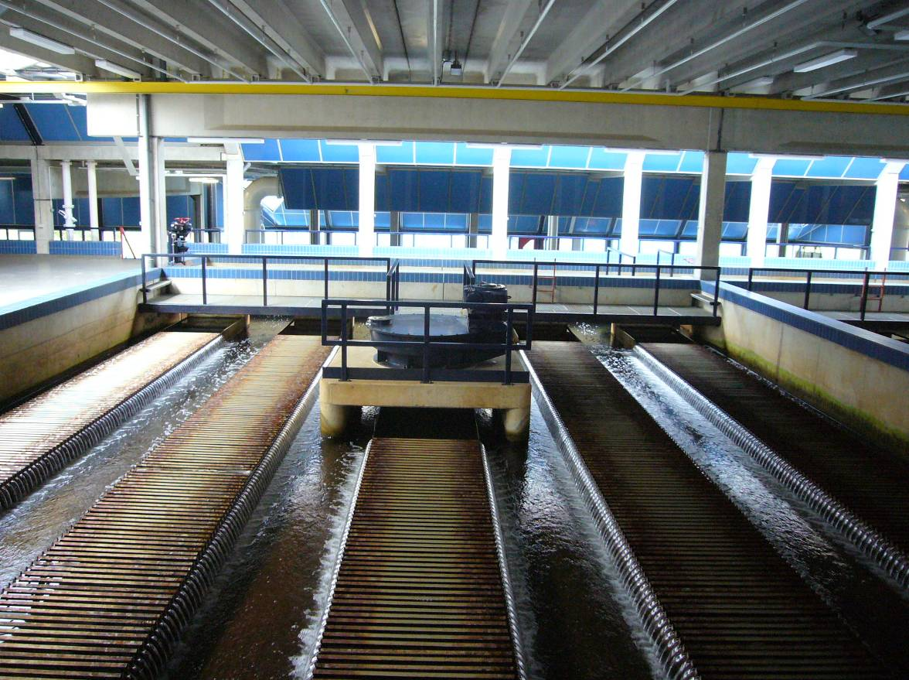
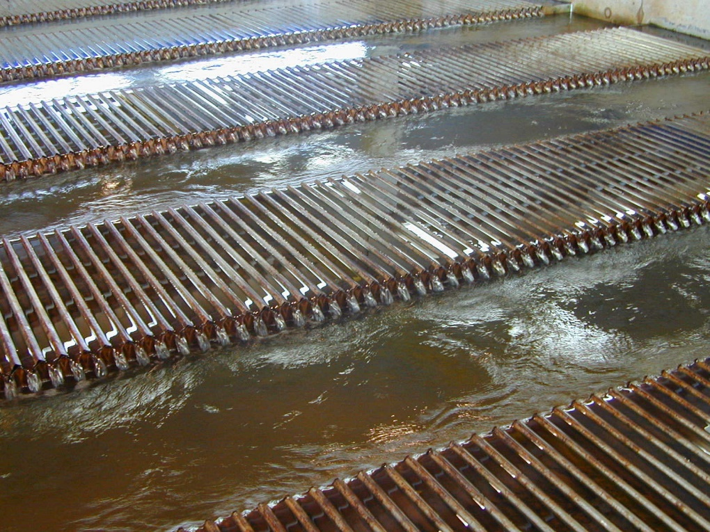
WPJ – Process flow
S = 0.8 – 1.2 m/h
Lake IJssel
drum screens
mixing
flocculation
sedimentation
RSF
GAC

Slide 26
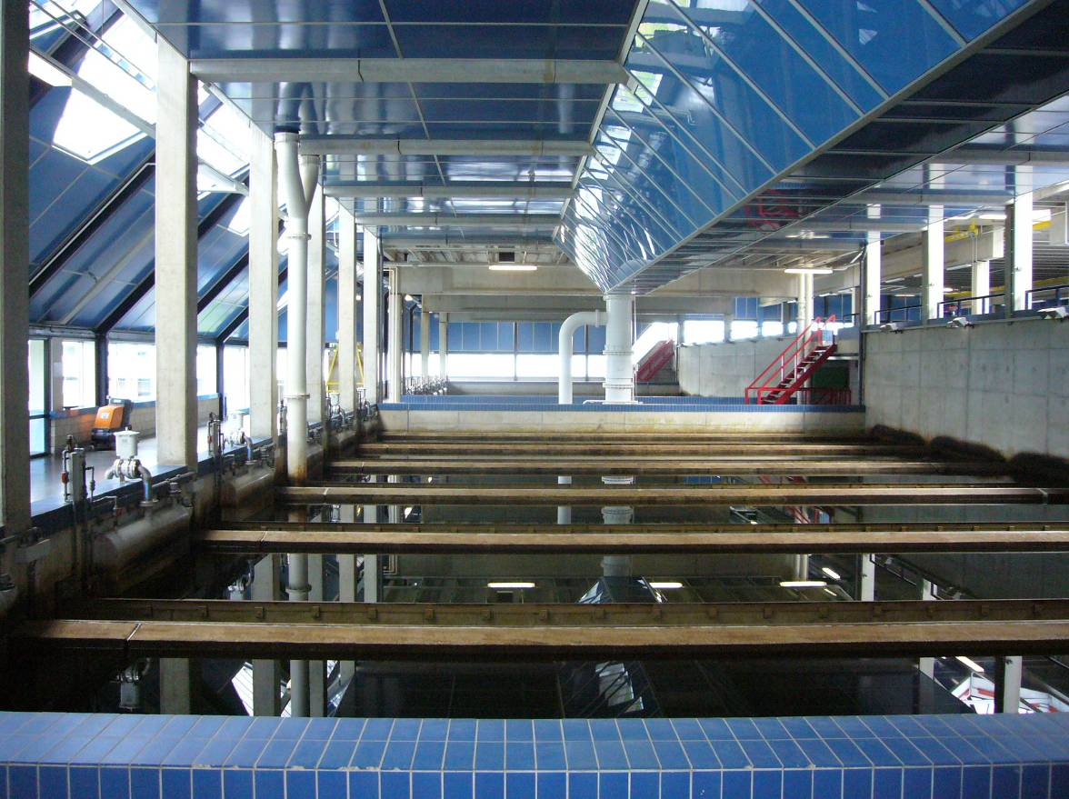
WPJ – Process flow
16 x 40 m²
v_{f} = 10 - 20 m/h
Lake IJssel
drum screens
mixing
flocculation
sedimentation
RSF
GAC

Slide 27
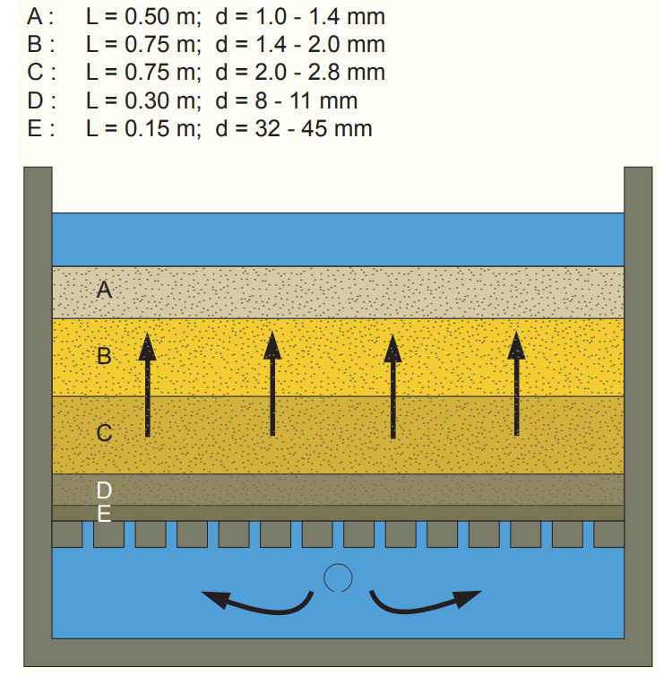
WPJ – Process flow
16 x 40 m²
v_{f} = 10 - 20 m/h
Lake IJssel
drum screens
mixing
flocculation
sedimentation
RSF
GAC

Slide 28
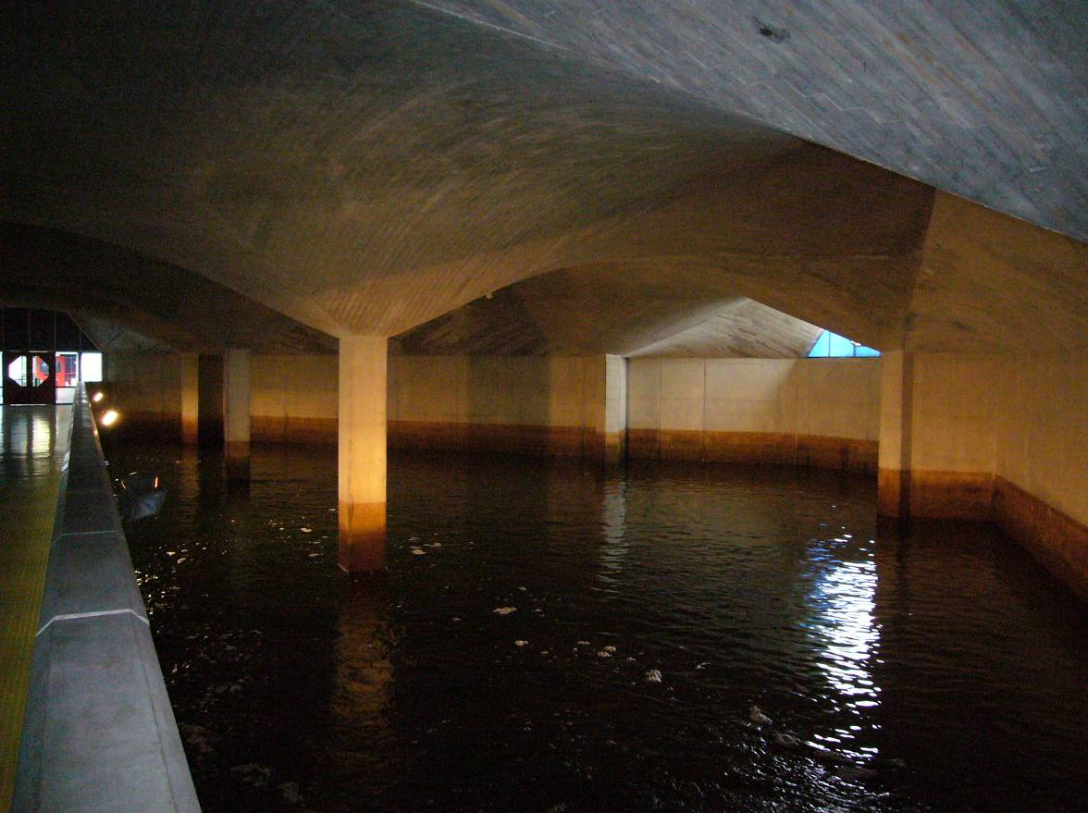
WPJ – Process flow
Lake IJssel
drum screens
mixing
flocculation
sedimentation
RSF
GAC

Slide 29
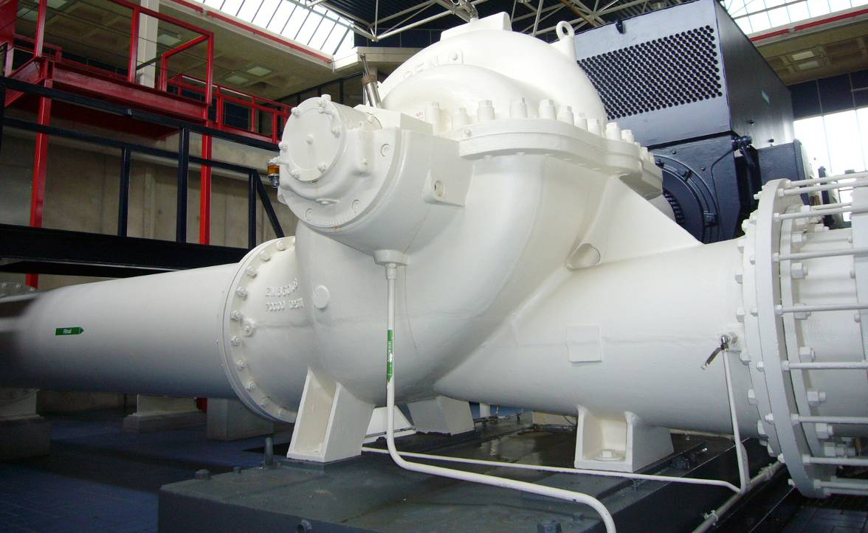
WPJ – Pumps building

Slide 30
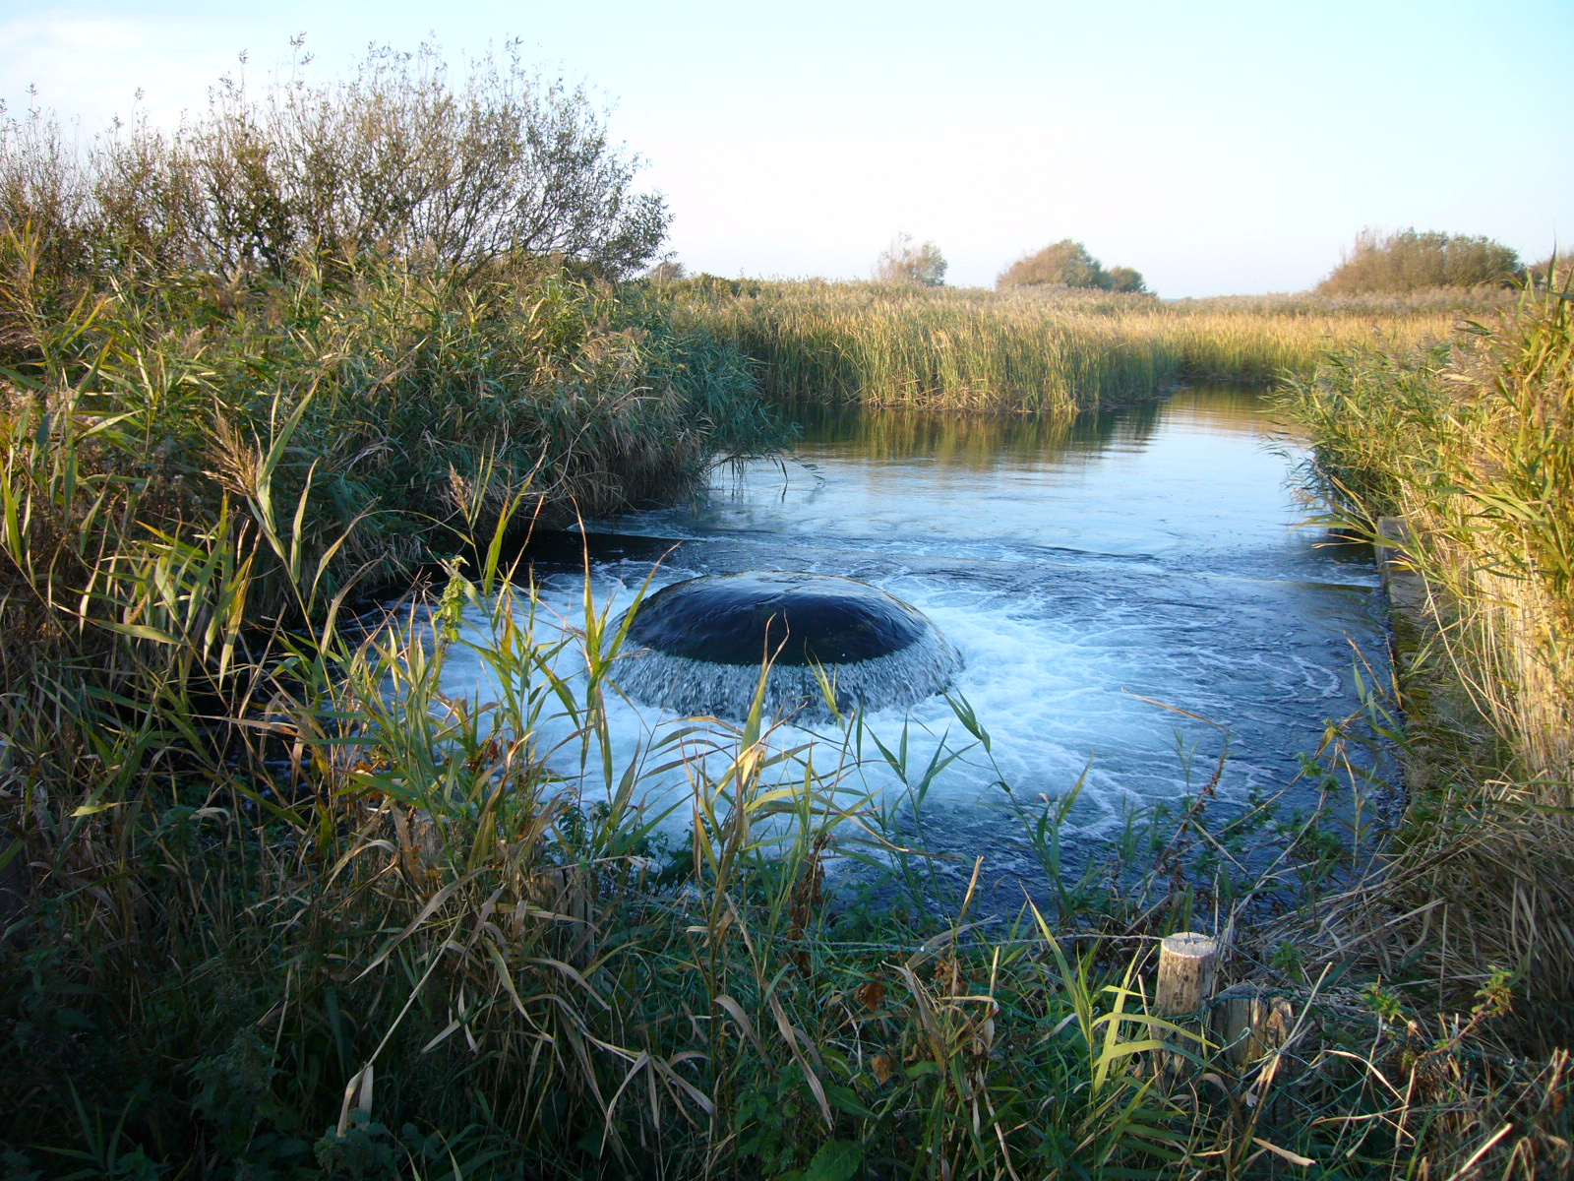
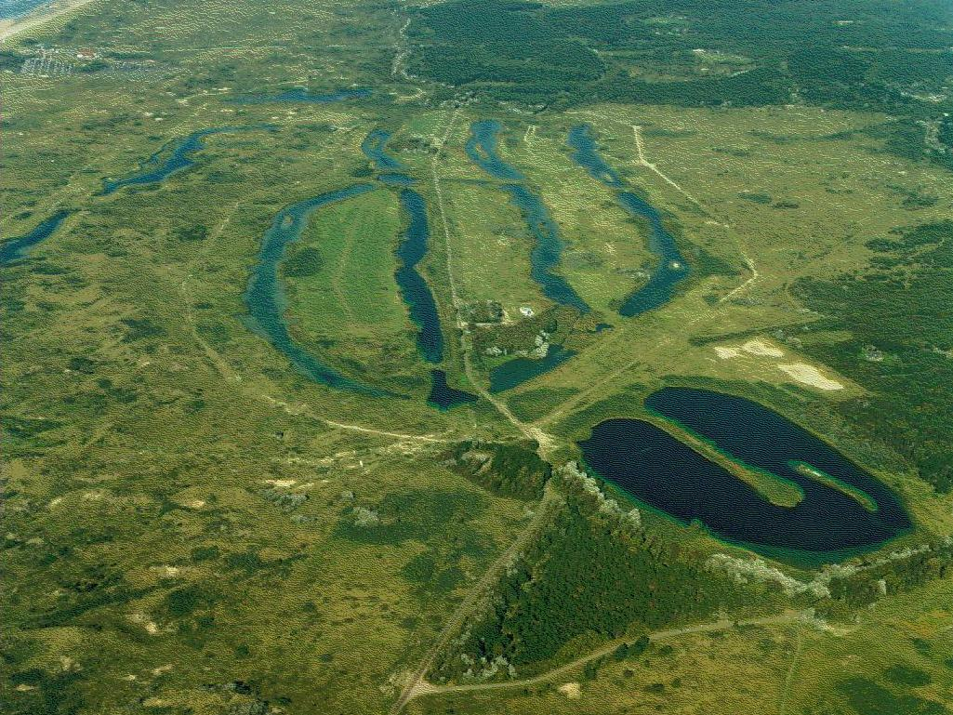
infiltration

Slide 31
Questions
emmanuelle.prest@pwnt.com
jink.gude@pwn.nl

